Slide 1

Classification (Till Decision Trees)
GOA COLLEGE OF ENGINEERING
Affiliated to Goa University
INFORMATION TECHNOLOGY DEPARTMENT
Vision
Impart high quality knowledge and skills to students in the field of Information Technology ,motivate research, encourage industry consultancy projects and nurture human values and life skills.
Prepared By,
Ms. Diana Miranda
Assistant Professor
Dept. of Information Technology
Goa College of Engineering

Slide 2
Topics to be Covered
Basic Concepts
Decision Tree Induction
Rule Based Classification
Bayesian Classification
Bayesian Belief Networks
K-Nearest Neighbours Classifier
Backpropagation
Model Evaluation and Selection
Support Vector Machines

Slide 3
Basic Concepts

Slide 4
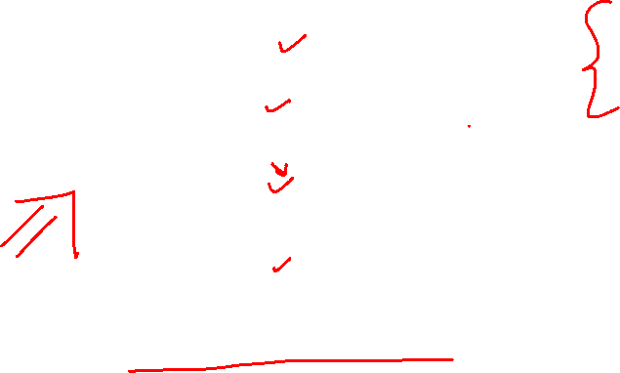
Catching tax-evasion
A new tax return for 2012
Is this a cheating tax return?
An instance of the classification problem: learn a method for discriminating between records of different classes (cheaters vs non-cheaters)
Tax-return data for year 2011

Slide 5
What is classification?
Classification is the task of learning a target function f that maps attribute set x to one of the predefined class labels y
categorical
categorical
continuous
class
One of the attributes is the class attribute
In this case: Cheat
Two class labels (or classes): Yes (1), No (0)

Slide 6

Illustrating Classification Task
Training set consists of records with known class labels
Training set is used to build a classification model
A labeled test set of previously unseen data records is used to evaluate the quality of the model.
The classification model is applied to new records with unknown class labels

Slide 7
X={x₁, x₂, x₃, …, x_{n}} depicts n measurements made on the tuple from n database attributes namely A={a₁,a₂,a₃,…a_{n}}
The target function f is known as a classification model
Y is the class label

Slide 8
The Classifier is built in 2 steps:
Training Phase
Also called learning step
The classification algorithm builds the classifier by analyzing a training set made up of tuples and their associated labels
Testing Phase
Used for the classification of the test set
Test set is independent of the training tuples

Slide 9
Why classification?
Descriptive modeling: Explanatory tool to distinguish between objects of different classes (e.g., understand why people cheat on their taxes)
Predictive modeling: Predict a class of a previously unseen record

Slide 10
Examples of Classification Tasks
Predicting tumor cells as benign or malignant
Classifying credit card transactions as legitimate or fraudulent
Categorizing news stories as finance, weather, entertainment, sports, etc
Identifying spam email, spam web pages
Understanding if a web query has commercial intent or not

Slide 11
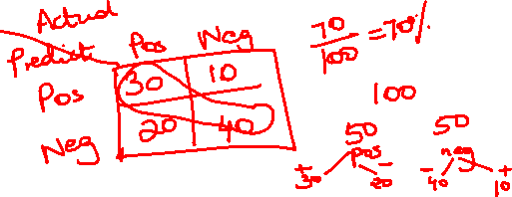
Evaluation of the Classifier
The known label of test samples is compared with the classified result from the model
Accuracy rate is the percentage of test set samples that are correctly classified by the model
Test set is independent of training set, otherwise over-fitting will occur
Overfitting: Model may incorporate some of the anomalies in the training dataset which may not be present in the general test data

Slide 12
Evaluation of classification models
Counts of test records that are correctly (or incorrectly) predicted by the classification model
Confusion matrix
Predicted Class
 | Class = 1 | Class = 0
Class = 1 | f₁₁ | f₁₀
Class = 0 | f₀₁ | f₀₀
Actual Class

Slide 13
Decision Tree Induction

Slide 14
Decision Tree Induction
Decision Tree Induction: Learning of decision trees from class labeled tuples
Decision tree
A flow-chart-like tree structure
Internal node denotes a test on an attribute
Branch represents an outcome of the test
Leaf nodes represent class labels or class distribution
Attribute Selection Measures
Tree Pruning

Slide 15
Example of a Decision Tree
categorical
categorical
continuous
class
Splitting Attributes
Refund
Yes
No
Test outcome
NO
MarSt
Single, Divorced
Married
TaxInc
NO
< 80K
> 80K
NO
YES
Class labels
Training Data
Model: Decision Tree

Slide 16
Another Example of Decision Tree
categorical
categorical
continuous
class
MarSt
Single, Divorced
Married
NO
Refund
Yes
No
NO
TaxInc
< 80K
> 80K
NO
YES
There could be more than one tree that fits the same data!

Slide 17
Decision Tree Classification Task
Decision Tree

Slide 18
Apply Model to Test Data
Test Data
Start from the root of tree.
Refund
Yes
No
NO
MarSt
Single, Divorced
Married
TaxInc
NO
< 80K
> 80K
NO
YES

Slide 19
Apply Model to Test Data
Test Data
Refund
Yes
No
NO
MarSt
Single, Divorced
Married
TaxInc
NO
< 80K
> 80K
NO
YES

Slide 20
Apply Model to Test Data
Test Data
Refund
Yes
No
NO
MarSt
Single, Divorced
Married
TaxInc
NO
< 80K
> 80K
NO
YES

Slide 21
Apply Model to Test Data
Test Data
Refund
Yes
No
NO
MarSt
Single, Divorced
Married
TaxInc
NO
< 80K
> 80K
NO
YES

Slide 22
Apply Model to Test Data
Test Data
Refund
Yes
No
NO
MarSt
Single, Divorced
Married
TaxInc
NO
< 80K
> 80K
NO
YES

Slide 23
Apply Model to Test Data
Test Data
Refund
Yes
No
NO
MarSt
Single, Divorced
Married
Assign Cheat to “No”
TaxInc
NO
< 80K
> 80K
NO
YES

Slide 24
Decision Tree Classification Task
Decision Tree

Slide 25
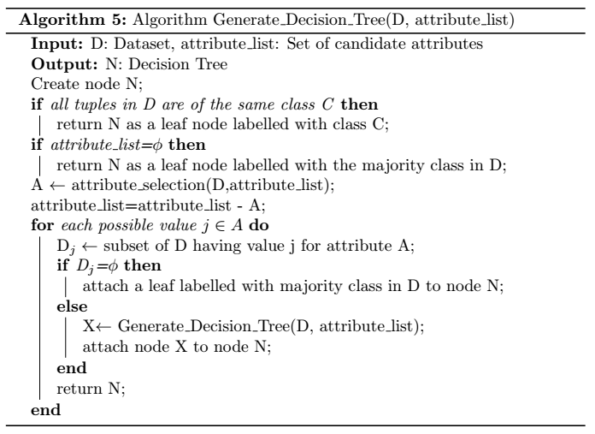
Algorithm for Decision Tree Induction

Slide 26
How to Specify Test Condition?
Depends on attribute types
Nominal
Ordinal
Continuous
Depends on number of ways to split
Binary split
Multi-way split

Slide 27
Splitting Based on Nominal Attributes
Multi-way split: Use as many partitions as distinct values.
Binary split: Divides values into two subsets. Need to find optimal partitioning.
CarType
Family
Luxury
Sports
CarType
OR
CarType
{Sports, Luxury}
{Family, Luxury}
{Family}
{Sports}

Slide 28
Splitting Based on Ordinal Attributes
Multi-way split: Use as many partitions as distinct values.
Binary split: Divides values into two subsets – respects the order. Need to find optimal partitioning.
Size
Small
Large
Medium
Size
Size
{Small, Medium}
OR
{Medium, Large}
{Large}
{Small}

Slide 29
Splitting Based on Continuous Attributes
Different ways of handling
Discretization to form an ordinal categorical attribute
Static – discretize once at the beginning
Dynamic – ranges can be found by equal interval bucketing, equal frequency bucketing (percentiles), or clustering.
Binary Decision: (A < v) or (A ≥ v)
consider all possible splits and finds the best cut
can be more compute intensive

Slide 30
Splitting Based on Continuous Attributes

Slide 31
How to determine the Best Split
Before Splitting: 10 records of class 0, 10 records of class 1
Which test condition is the best?

Slide 32
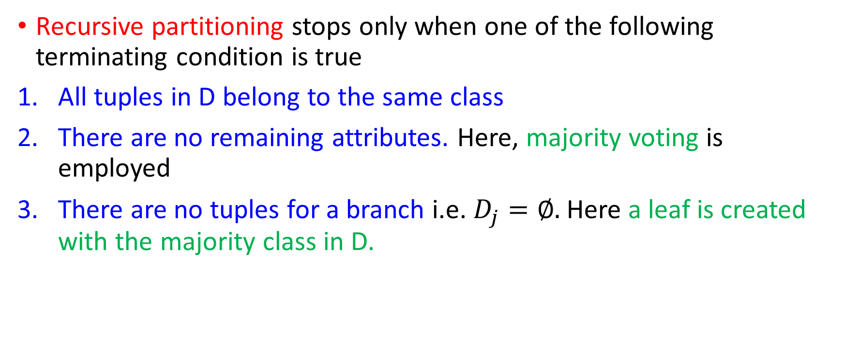
Stopping Criteria
Recursive partitioning stops only when one of the following terminating condition is true
All tuples in D belong to the same class
There are no remaining attributes. Here, majority voting is employed
There are no tuples for a branch i.e. $D_{j}=∅.$ Here a leaf is created with the majority class in D.

Slide 33
Complexity
O(n x |D| x log(|D|))
N: No. of attributes
|D|: No. of training tuples

Slide 34
Attribute Selection Measures
Heuristic for selecting the splitting criteria that best separates a given data partition D into individual classes
Also called splitting rules: Because they determine how the tuples at each node are going to split
Splitting attribute: Attribute having the best score for the measure
If the splitting attribute is continuous valued or if we are restricting to binary trees: Either a split point or a splitting subset must also be determined as part of the splitting criterion

Slide 35
D: Training dataset
C_{i}: m distinct classes where i=1,…,m
C_{i,D}: set of tuples of class C_{i} in D
|D|: number of tuples in D
| C_{i,D} |: number of tuples in C_{i,D}
Attribute selection measures:
Information Gain
Gain Ratio
Gini Index

Slide 36
Information Gain
Used in ID3
Select the attribute with the highest information gain
Let p_{i} be the probability that an arbitrary tuple in D belongs to class C_{i}, estimated by|C_{i, D}|/|D|
Expected information (Entropy) needed to classify a tuple in D:
Information needed (after using A to split D into v partitions) to classify D:
Information gained by branching on attribute A
Notes:
I : the expected information needed to classify a given sample
E (entropy) : expected information based on the partitioning into subsets by A

Slide 37
RID | age | income | student | credit rating | Class: buys_computer
1 | youth | high | no | fair | no
2 | youth | high | no | excellent | no
3 | middle | high | no | fair | yes
4 | senior | medium | no | fair | yes
5 | senior | low | yes | fair | yes
6 | senior | low | yes | excellent | no
7 | middle | low | yes | excellent | yes
8 | youth | medium | no | fair | no
9 | youth | low | yes | fair | yes
10 | senior | medium | yes | fair | yes
11 | youth | medium | yes | excellent | yes
12 | middle | medium | no | excellent | yes
13 | middle | high | yes | fair | yes
14 | senior | medium | no | excellent | no

Slide 38
RID | age | income | student | credit rating | Class: buys_computer
1 | youth | high | no | fair | no
2 | youth | high | no | excellent | no
3 | middle | high | no | fair | yes
4 | senior | medium | no | fair | yes
5 | senior | low | yes | fair | yes
6 | senior | low | yes | excellent | no
7 | middle | low | yes | excellent | yes
8 | youth | medium | no | fair | no
9 | youth | low | yes | fair | yes
10 | senior | medium | yes | fair | yes
11 | youth | medium | yes | excellent | yes
12 | middle | medium | no | excellent | yes
13 | middle | high | yes | fair | yes
14 | senior | medium | no | excellent | no
Class P: buys_computer = “yes”
Class N: buys_computer = “no”

Slide 39

RID | age | Class: buys_computer
1 | youth | no
2 | youth | no
3 | middle | yes
4 | senior | yes
5 | senior | yes
6 | senior | no
7 | middle | yes
8 | youth | no
9 | youth | yes
10 | senior | yes
11 | youth | yes
12 | middle | yes
13 | middle | yes
14 | senior | no
What is Info_{age}(D)?
Age has 3 attribute values: youth, middle and senior
First: For Youth
$$Info_{age} \left(D\right)=\frac{5 }{14}I\left(2,3\right)+$$

Slide 40
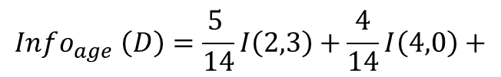
RID | age | Class: buys_computer
1 | youth | no
2 | youth | no
3 | middle | yes
4 | senior | yes
5 | senior | yes
6 | senior | no
7 | middle | yes
8 | youth | no
9 | youth | yes
10 | senior | yes
11 | youth | yes
12 | middle | yes
13 | middle | yes
14 | senior | no
What is Info_{age}(D)?
Age has 3 attribute values: youth, middle and senior
Next: For Middle
$$Info_{age} \left(D\right)=\frac{5 }{14}I\left(2,3\right)+\frac{4}{14}I\left(4,0\right)+$$

Slide 41
RID | age | Class: buys_computer
1 | youth | no
2 | youth | no
3 | middle | yes
4 | senior | yes
5 | senior | yes
6 | senior | no
7 | middle | yes
8 | youth | no
9 | youth | yes
10 | senior | yes
11 | youth | yes
12 | middle | yes
13 | middle | yes
14 | senior | no
What is Info_{age}(D)?
Age has 3 attribute values: youth, middle and senior
Next: For Senior
$Info_{age} \left(D\right)=\frac{5 }{14}I\left(2,3\right)+\frac{4}{14}I\left(4,0\right)+\frac{5}{14}I\left(3,2\right)=$ 0.694

Slide 42
RID | age | income | student | credit rating | Class: buys_computer
1 | youth | high | no | fair | no
2 | youth | high | no | excellent | no
3 | middle | high | no | fair | yes
4 | senior | medium | no | fair | yes
5 | senior | low | yes | fair | yes
6 | senior | low | yes | excellent | no
7 | middle | low | yes | excellent | yes
8 | youth | medium | no | fair | no
9 | youth | low | yes | fair | yes
10 | senior | medium | yes | fair | yes
11 | youth | medium | yes | excellent | yes
12 | middle | medium | no | excellent | yes
13 | middle | high | yes | fair | yes
14 | senior | medium | no | excellent | no
Calculate Gain
$$Info_{age} \left(D\right)=0.694$$
42

Slide 43
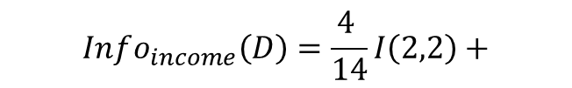
RID | income | Class: buys_computer
1 | high | no
2 | high | no
3 | high | yes
4 | medium | yes
5 | low | yes
6 | low | no
7 | low | yes
8 | medium | no
9 | low | yes
10 | medium | yes
11 | medium | yes
12 | medium | yes
13 | high | yes
14 | medium | no
What is Info_{income}(D)?
Income has 3 attribute values: high, medium and low
For “High”
$$Info_{income}\left(D\right)=\frac{4 }{14}I\left(2,2\right)+$$

Slide 44
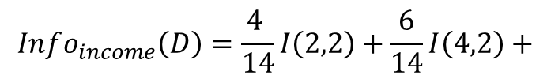
RID | income | Class: buys_computer
1 | high | no
2 | high | no
3 | high | yes
4 | medium | yes
5 | low | yes
6 | low | no
7 | low | yes
8 | medium | no
9 | low | yes
10 | medium | yes
11 | medium | yes
12 | medium | yes
13 | high | yes
14 | medium | no
What is Info_{income}(D)?
Income has 3 attribute values: high, medium and low
For “Medium”
$$Info_{income}\left(D\right)=\frac{4 }{14}I\left(2,2\right)+\frac{6}{14}I\left(4,2\right)+$$

Slide 45
RID | income | Class: buys_computer
1 | high | no
2 | high | no
3 | high | yes
4 | medium | yes
5 | low | yes
6 | low | no
7 | low | yes
8 | medium | no
9 | low | yes
10 | medium | yes
11 | medium | yes
12 | medium | yes
13 | high | yes
14 | medium | no
What is Info_{income}(D)?
Income has 3 attribute values: high, medium and low
For “Low”
$Info_{income}\left(D\right)=\frac{4 }{14}I\left(2,2\right)+\frac{6}{14}I\left(4,2\right)+\frac{4}{14}I(3,1)$=0.91156

Slide 46

RID | income | Class: buys_computer
1 | high | no
2 | high | no
3 | high | yes
4 | medium | yes
5 | low | yes
6 | low | no
7 | low | yes
8 | medium | no
9 | low | yes
10 | medium | yes
11 | medium | yes
12 | medium | yes
13 | high | yes
14 | medium | no
Calculate Gain
$$Info_{income} \left(D\right)=0.91156$$
$Gain=Info\left(D\right)−Info_{income}(D$)=0.0287

Slide 47
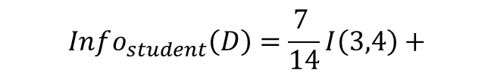
RID | student | Class: buys_computer
1 | no | no
2 | no | no
3 | no | yes
4 | no | yes
5 | yes | yes
6 | yes | no
7 | yes | yes
8 | no | no
9 | yes | yes
10 | yes | yes
11 | yes | yes
12 | no | yes
13 | yes | yes
14 | no | no
What is Info_{student}(D)?
Student has 2 attribute values: No and Yes
For “No”
$$Info_{student}\left(D\right)=\frac{7 }{14}I\left(3,4\right)+$$

Slide 48
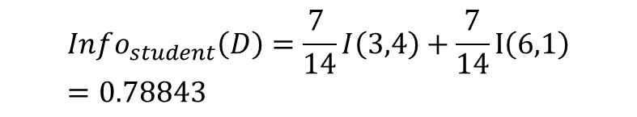
RID | student | Class: buys_computer
1 | no | no
2 | no | no
3 | no | yes
4 | no | yes
5 | yes | yes
6 | yes | no
7 | yes | yes
8 | no | no
9 | yes | yes
10 | yes | yes
11 | yes | yes
12 | no | yes
13 | yes | yes
14 | no | no
What is Info_{student}(D)?
For “Yes”
$$Info_{student}\left(D\right)=\frac{7 }{14}I\left(3,4\right)+\frac{7}{14}I\left(6,1\right)=0.78843$$

Slide 49

RID | student | Class: buys_computer
1 | no | no
2 | no | no
3 | no | yes
4 | no | yes
5 | yes | yes
6 | yes | no
7 | yes | yes
8 | no | no
9 | yes | yes
10 | yes | yes
11 | yes | yes
12 | no | yes
13 | yes | yes
14 | no | no
Calculate Gain
$$Info_{student} \left(D\right)=0.78843$$
$Gain=Info\left(D\right)−Info_{student}(D$)=0.1518

Slide 50
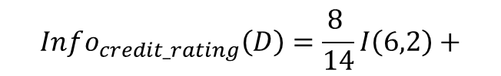
RID | credit rating | Class: buys_computer
1 | fair | no
2 | excellent | no
3 | fair | yes
4 | fair | yes
5 | fair | yes
6 | excellent | no
7 | excellent | yes
8 | fair | no
9 | fair | yes
10 | fair | yes
11 | excellent | yes
12 | excellent | yes
13 | fair | yes
14 | excellent | no
What is Info_{credit_rating}(D)?
Credit Rating has 2 attribute values: Fair and Excellent
For “Fair”
$$Info_{credit_rating}\left(D\right)=\frac{8 }{14}I\left(6,2\right)+$$

Slide 51
RID | credit rating | Class: buys_computer
1 | fair | no
2 | excellent | no
3 | fair | yes
4 | fair | yes
5 | fair | yes
6 | excellent | no
7 | excellent | yes
8 | fair | no
9 | fair | yes
10 | fair | yes
11 | excellent | yes
12 | excellent | yes
13 | fair | yes
14 | excellent | no
What is Info_{credit_rating}(D)?
Credit Rating has 2 attribute values: Fair and Excellent
For “Excellent”
$Info_{credit_rating}\left(D\right)=\frac{8 }{14}I\left(6,2\right)+\frac{6}{14}I\left(3,3\right)=$0.8922

Slide 52
RID | credit rating | Class: buys_computer
1 | fair | no
2 | excellent | no
3 | fair | yes
4 | fair | yes
5 | fair | yes
6 | excellent | no
7 | excellent | yes
8 | fair | no
9 | fair | yes
10 | fair | yes
11 | excellent | yes
12 | excellent | yes
13 | fair | yes
14 | excellent | no
Calculate Gain
$$Info_{credit_rating} \left(D\right)=0.8922$$
$Gain=Info\left(D\right)−Info_{credit_rating}(D$)=0.04813

Slide 53
Info
0.6936
0.91156
0.78843
0.8922
Gain
0.2467
0.0287
0.1518
0.04813
RID | age | income | student | credit rating | Class: buys_computer
1 | youth | high | no | fair | no
2 | youth | high | no | excellent | no
3 | middle | high | no | fair | yes
4 | senior | medium | no | fair | yes
5 | senior | low | yes | fair | yes
6 | senior | low | yes | excellent | no
7 | middle | low | yes | excellent | yes
8 | youth | medium | no | fair | no
9 | youth | low | yes | fair | yes
10 | senior | medium | yes | fair | yes
11 | youth | medium | yes | excellent | yes
12 | middle | medium | no | excellent | yes
13 | middle | high | yes | fair | yes
14 | senior | medium | no | excellent | no
Info_{age}(D)
Info_{income}(D)
Info_{student}(D)
Info_{credit_rating}(D)
Which attribute is chosen?

Slide 54
RID | age | Class: buys_computer
1 | youth | no
2 | youth | no
3 | middle | yes
4 | senior | yes
5 | senior | yes
6 | senior | no
7 | middle | yes
8 | youth | no
9 | youth | yes
10 | senior | yes
11 | youth | yes
12 | middle | yes
13 | middle | yes
14 | senior | no
age?
1 to 14
Youth
Senior
1, 2, 8, 9, 11
Middle
4, 5, 6, 10, 14
3, 7, 12, 13

Slide 55
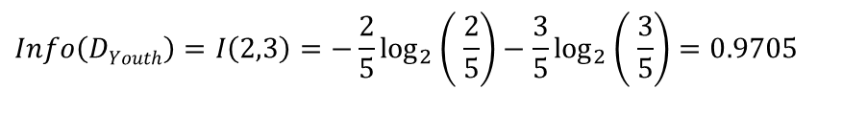
RID | age | income | student | credit rating | Class: buys_computer
1 | youth | high | no | fair | no
2 | youth | high | no | excellent | no
8 | youth | medium | no | fair | no
9 | youth | low | yes | fair | yes
11 | youth | medium | yes | excellent | yes
Class P: buys_computer = “yes”
Class N: buys_computer = “no”
$$Info\left(DYouth\right)=I\left(2,3\right)=−\frac{2}{5}\log_{2}\left( \frac{2}{5}\right)−\frac{3}{5}\log_{2}\left( \frac{3}{5}\right)=0.9705$$

Slide 56
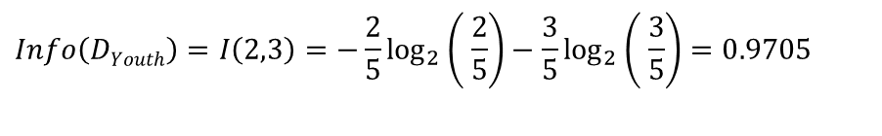
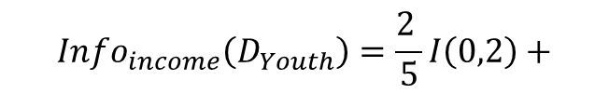
$$Info\left(DYouth\right)=I\left(2,3\right)=−\frac{2}{5}\log_{2}\left( \frac{2}{5}\right)−\frac{3}{5}\log_{2}\left( \frac{3}{5}\right)=0.9705$$
RID | age | income | Class: buys_computer
1 | youth | high | no
2 | youth | high | no
8 | youth | medium | no
9 | youth | low | yes
11 | youth | medium | yes
What is Info_{income}(D_{Youth})?
Income has 3 attribute values: high, medium and low
For “High”
$$Info_{income}\left(D_{Youth}\right)=\frac{2 }{5}I\left(0,2\right)+$$

Slide 57
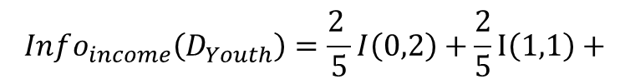
$$Info\left(DYouth\right)=I\left(2,3\right)=−\frac{2}{5}\log_{2}\left( \frac{2}{5}\right)−\frac{3}{5}\log_{2}\left( \frac{3}{5}\right)=0.9705$$
RID | age | income | Class: buys_computer
1 | youth | high | no
2 | youth | high | no
8 | youth | medium | no
9 | youth | low | yes
11 | youth | medium | yes
What is Info_{income}(D_{Youth})?
Income has 3 attribute values: high, medium and low
For “Medium”
$$Info_{income}\left(D_{Youth}\right)=\frac{2 }{5}I\left(0,2\right)+\frac{2}{5}I\left(1,1\right)+$$

Slide 58
$$Info\left(DYouth\right)=I\left(2,3\right)=−\frac{2}{5}\log_{2}\left( \frac{2}{5}\right)−\frac{3}{5}\log_{2}\left( \frac{3}{5}\right)=0.9705$$
RID | age | income | Class: buys_computer
1 | youth | high | no
2 | youth | high | no
8 | youth | medium | no
9 | youth | low | yes
11 | youth | medium | yes
What is Info_{income}(D_{Youth})?
Income has 3 attribute values: high, medium and low
For “Low”
$$Info_{income}\left(D_{Youth}\right)=\frac{2 }{5}I\left(0,2\right)+\frac{2}{5}I\left(1,1\right)+\frac{1}{5}I\left(1,0\right)=0.4$$

Slide 59
$$Info\left(DYouth\right)=I\left(2,3\right)=−\frac{2}{5}\log_{2}\left( \frac{2}{5}\right)−\frac{3}{5}\log_{2}\left( \frac{3}{5}\right)=0.9705$$
RID | age | income | Class: buys_computer
1 | youth | high | no
2 | youth | high | no
8 | youth | medium | no
9 | youth | low | yes
11 | youth | medium | yes
$$Info_{income}\left(D_{Youth}\right)=\frac{2 }{5}I\left(0,2\right)+\frac{2}{5}I\left(1,1\right)+\frac{1}{5}I\left(1,0\right)=0.4$$
Calculate Gain
$Gain=Info\left(D_{Youth}\right)−Info_{income}(D_{Youth}$)=0.5705

Slide 60
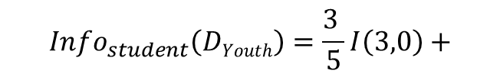
$$Info\left(DYouth\right)=I\left(2,3\right)=−\frac{2}{5}\log_{2}\left( \frac{2}{5}\right)−\frac{3}{5}\log_{2}\left( \frac{3}{5}\right)=0.9705$$
RID | age | student | Class: buys_computer
1 | youth | no | no
2 | youth | no | no
8 | youth | no | no
9 | youth | yes | yes
11 | youth | yes | yes
What is Info_{student}(D_{Youth})?
Student has 2 attribute values: No and Yes
For “No”
$$Info_{student}\left(DYouth\right)=\frac{3 }{5}I\left(3,0\right)+$$

Slide 61

$$Info\left(DYouth\right)=I\left(2,3\right)=−\frac{2}{5}\log_{2}\left( \frac{2}{5}\right)−\frac{3}{5}\log_{2}\left( \frac{3}{5}\right)=0.9705$$
RID | age | student | Class: buys_computer
1 | youth | no | no
2 | youth | no | no
8 | youth | no | no
9 | youth | yes | yes
11 | youth | yes | yes
What is Info_{student}(D_{Youth})?
Student has 2 attribute values: No and Yes
For “Yes”
$Info_{student}\left(DYouth\right)=\frac{3 }{5}I\left(0,3\right)+\frac{2}{5}I(2,0)$=0

Slide 62
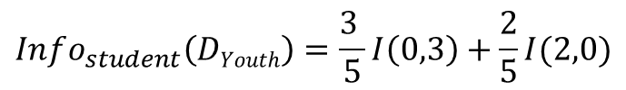
$$Info\left(DYouth\right)=I\left(2,3\right)=−\frac{2}{5}\log_{2}\left( \frac{2}{5}\right)−\frac{3}{5}\log_{2}\left( \frac{3}{5}\right)=0.9705$$
RID | age | income | Class: buys_computer
1 | youth | high | no
2 | youth | high | no
8 | youth | medium | no
9 | youth | low | yes
11 | youth | medium | yes
$$Info_{student}\left(DYouth\right)=\frac{3 }{5}I\left(0,3\right)+\frac{2}{5}I(2,0)$$
Calculate Gain
$Gain=Info\left(D_{Youth}\right)−$ $Info_{student}\left(DYouth\right)$=0.9705

Slide 63

Info
0.4
0
Gain
0.57095
0.97095
Info_{income}(D_{Y})
Info_{student}(D_{Y})
Info_{credit_rating}(D_{Y})
RID | age | income | student | credit rating | Class: buys_computer
1 | youth | high | no | fair | no
2 | youth | high | no | excellent | no
8 | youth | medium | no | fair | no
9 | youth | low | yes | fair | yes
11 | youth | medium | yes | excellent | yes
Which attribute is chosen?
63

Slide 64
RID | age | income | student | credit rating | Class: buys_computer
1 | youth | high | no | fair | no
2 | youth | high | no | excellent | no
8 | youth | medium | no | fair | no
9 | youth | low | yes | fair | yes
11 | youth | medium | yes | excellent | yes
age?
1 to 14
1, 2, 8, 9, 11
Youth
Senior
Middle
4, 5, 6, 10, 14
Student?
3, 7, 12, 13
Yes
No
9, 11
1, 2, 8
Yes
No

Slide 65
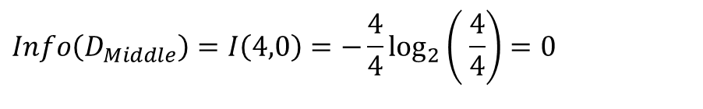
$$Info\left(D_{Middle}\right)=I\left(4,0\right)=−\frac{4}{4}\log_{2}\left( \frac{4}{4}\right)=0$$
RID | age | income | student | credit rating | Class: buys_computer
3 | middle | high | no | fair | yes
7 | middle | low | yes | excellent | yes
12 | middle | medium | no | excellent | yes
13 | middle | high | yes | fair | yes
age?
1 to 14
1, 2, 8, 9, 11
Youth
Senior
Middle
4, 5, 6, 10, 14
Student?
3, 7, 12, 13
Yes
No
Yes
9, 11
1, 2, 8
Yes
No

Slide 66
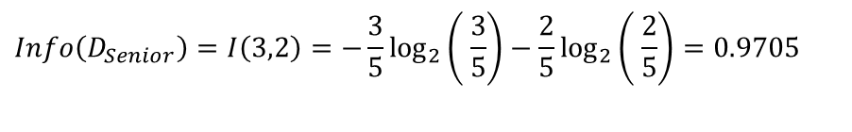
Class P: buys_computer = “yes”
Class N: buys_computer = “no”
RID | age | income | student | credit rating | Class: buys_computer
4 | senior | medium | no | fair | yes
5 | senior | low | yes | fair | yes
6 | senior | low | yes | excellent | no
10 | senior | medium | yes | fair | yes
14 | senior | medium | no | excellent | no
$$Info\left(D_{Senior}\right)=I\left(3,2\right)=−\frac{3}{5}\log_{2}\left( \frac{3}{5}\right)−\frac{2}{5}\log_{2}\left( \frac{2}{5}\right)=0.9705$$

Slide 67
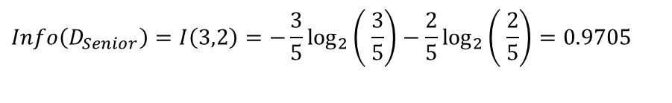
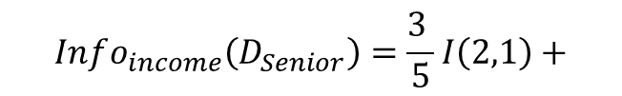
$$Info\left(D_{Senior}\right)=I\left(3,2\right)=−\frac{3}{5}\log_{2}\left( \frac{3}{5}\right)−\frac{2}{5}\log_{2}\left( \frac{2}{5}\right)=0.9705$$
RID | age | income | student | credit rating | Class: buys_computer
4 | senior | medium | no | fair | yes
5 | senior | low | yes | fair | yes
6 | senior | low | yes | excellent | no
10 | senior | medium | yes | fair | yes
14 | senior | medium | no | excellent | no
What is Info_{income}(D_{senior})?
Income has 3 attribute values: high, medium and low
For “Medium”
$$Info_{income}\left(D_{Senior}\right)=\frac{3 }{5}I\left(2,1\right)+$$
For “High”: No Values

Slide 68
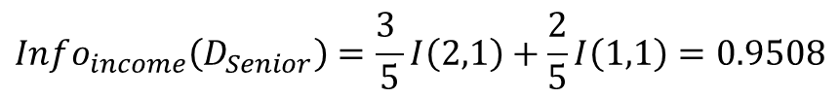
$$Info\left(D_{Senior}\right)=I\left(3,2\right)=−\frac{3}{5}\log_{2}\left( \frac{3}{5}\right)−\frac{2}{5}\log_{2}\left( \frac{2}{5}\right)=0.9705$$
RID | age | income | student | credit rating | Class: buys_computer
4 | senior | medium | no | fair | yes
5 | senior | low | yes | fair | yes
6 | senior | low | yes | excellent | no
10 | senior | medium | yes | fair | yes
14 | senior | medium | no | excellent | no
What is Info_{income}(D_{senior})?
Income has 3 attribute values: high, medium and low
For “Low”
$$Info_{income}\left(D_{Senior}\right)=\frac{3 }{5}I\left(2,1\right)+\frac{2}{5}I\left(1,1\right)=0.9508$$
For “High”: No Values

Slide 69
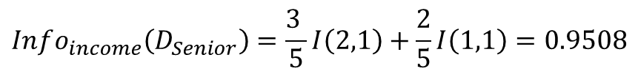
$$Info\left(D_{Senior}\right)=I\left(3,2\right)=−\frac{3}{5}\log_{2}\left( \frac{3}{5}\right)−\frac{2}{5}\log_{2}\left( \frac{2}{5}\right)=0.9705$$
RID | age | income | student | credit rating | Class: buys_computer
4 | senior | medium | no | fair | yes
5 | senior | low | yes | fair | yes
6 | senior | low | yes | excellent | no
10 | senior | medium | yes | fair | yes
14 | senior | medium | no | excellent | no
$$Info_{income}\left(D_{Senior}\right)=\frac{3 }{5}I\left(2,1\right)+\frac{2}{5}I\left(1,1\right)=0.9508$$
Calculate Gain
$Gain=Info\left(D_{Senior}\right)−$ $Info_{income}\left(D_{Senior}\right)$=0.01997

Slide 70
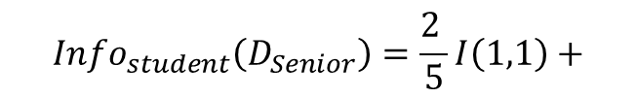
$$Info\left(D_{Senior}\right)=I\left(3,2\right)=−\frac{3}{5}\log_{2}\left( \frac{3}{5}\right)−\frac{2}{5}\log_{2}\left( \frac{2}{5}\right)=0.9705$$
RID | age | income | student | credit rating | Class: buys_computer
4 | senior | medium | no | fair | yes
5 | senior | low | yes | fair | yes
6 | senior | low | yes | excellent | no
10 | senior | medium | yes | fair | yes
14 | senior | medium | no | excellent | no
What is Info_{student}(D_{senior})?
Student has 2 attribute values: No and Yes
For “No”
$$Info_{student}\left(D_{Senior}\right)=\frac{2 }{5}I\left(1,1\right)+$$

Slide 71

$$Info\left(D_{Senior}\right)=I\left(3,2\right)=−\frac{3}{5}\log_{2}\left( \frac{3}{5}\right)−\frac{2}{5}\log_{2}\left( \frac{2}{5}\right)=0.9705$$
RID | age | income | student | credit rating | Class: buys_computer
4 | senior | medium | no | fair | yes
5 | senior | low | yes | fair | yes
6 | senior | low | yes | excellent | no
10 | senior | medium | yes | fair | yes
14 | senior | medium | no | excellent | no
What is Info_{student}(D_{senior})?
Student has 2 attribute values: No and Yes
For “Yes”
$Info_{student}\left(D_{Senior}\right)=\frac{2 }{5}I\left(1,1\right)+\frac{3}{5}I\left(2,1\right)=$0.9508

Slide 72

$$Info\left(D_{Senior}\right)=I\left(3,2\right)=−\frac{3}{5}\log_{2}\left( \frac{3}{5}\right)−\frac{2}{5}\log_{2}\left( \frac{2}{5}\right)=0.9705$$
RID | age | income | student | credit rating | Class: buys_computer
4 | senior | medium | no | fair | yes
5 | senior | low | yes | fair | yes
6 | senior | low | yes | excellent | no
10 | senior | medium | yes | fair | yes
14 | senior | medium | no | excellent | no
$Info_{student}\left(D_{Senior}\right)=\frac{2 }{5}I\left(1,1\right)+\frac{3}{5}I\left(2,1\right)=$0.9508
Calculate Gain
$Gain=Info\left(D_{Senior}\right)−$ $Info_{student}\left(D_{Senior}\right)$=0.01997

Slide 73
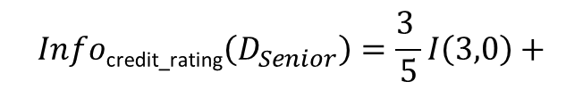
$$Info\left(D_{Senior}\right)=I\left(3,2\right)=−\frac{3}{5}\log_{2}\left( \frac{3}{5}\right)−\frac{2}{5}\log_{2}\left( \frac{2}{5}\right)=0.9705$$
RID | age | income | student | credit rating | Class: buys_computer
4 | senior | medium | no | fair | yes
5 | senior | low | yes | fair | yes
6 | senior | low | yes | excellent | no
10 | senior | medium | yes | fair | yes
14 | senior | medium | no | excellent | no
What is Info_{credit_rating}(D_{senior})?
Credit_Rating has 2 attribute values: Fair and Excellent
For “Fair”
$$Info\text{credit}\text{_}\text{rating}\left(D_{Senior}\right)=\frac{3 }{5}I\left(3,0\right)+$$

Slide 74
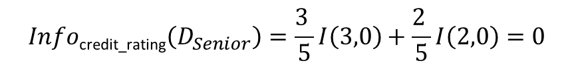
$$Info\left(D_{Senior}\right)=I\left(3,2\right)=−\frac{3}{5}\log_{2}\left( \frac{3}{5}\right)−\frac{2}{5}\log_{2}\left( \frac{2}{5}\right)=0.9705$$
RID | age | income | student | credit rating | Class: buys_computer
4 | senior | medium | no | fair | yes
5 | senior | low | yes | fair | yes
6 | senior | low | yes | excellent | no
10 | senior | medium | yes | fair | yes
14 | senior | medium | no | excellent | no
What is Info_{credit_rating}(D_{senior})?
Credit_Rating has 2 attribute values: Fair and Excellent
For “Excellent”
$$Info\text{credit}\text{_}\text{rating}\left(D_{Senior}\right)=\frac{3 }{5}I\left(3,0\right)+\frac{2 }{5}I\left(2,0\right)=0$$

Slide 75
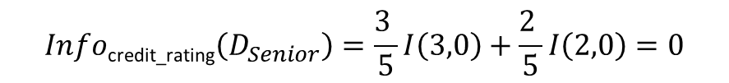
$$Info\left(D_{Senior}\right)=I\left(3,2\right)=−\frac{3}{5}\log_{2}\left( \frac{3}{5}\right)−\frac{2}{5}\log_{2}\left( \frac{2}{5}\right)=0.9705$$
RID | age | income | student | credit rating | Class: buys_computer
4 | senior | medium | no | fair | yes
5 | senior | low | yes | fair | yes
6 | senior | low | yes | excellent | no
10 | senior | medium | yes | fair | yes
14 | senior | medium | no | excellent | no
$$Info\text{credit}\text{_}\text{rating}\left(D_{Senior}\right)=\frac{3 }{5}I\left(3,0\right)+\frac{2 }{5}I\left(2,0\right)=0$$
Calculate Gain
$Gain=Info\left(D_{Senior}\right)−Info\text{credit}\text{_}\text{rating}\left(D_{Senior}\right)$=0.9705

Slide 76

RID | age | income | student | credit rating | Class: buys_computer
4 | senior | medium | no | fair | yes
5 | senior | low | yes | fair | yes
6 | senior | low | yes | excellent | no
10 | senior | medium | yes | fair | yes
14 | senior | medium | no | excellent | no
Info
0.9508
0.9508
0
Gain
0.01997
0.01997
0.97095
Info_{income}(D_{S})
Info_{student}(D_{S})
Info_{credit_rating}(D_{S})
age?
1 to 14
Which attribute is chosen?
1, 2, 8, 9, 11
Youth
Senior
Middle
4, 5, 6, 10, 14
Student?
3, 7, 12, 13
Credit Rating?
Yes
No
Yes
Fair
Excellent
9, 11
1, 2, 8
4, 5, 10
6, 14
Yes
No
Yes
No
76

Slide 77
Gain Ratio for Attribute Selection
Information gain measure is biased towards attributes with a large number of values
C4.5 (a successor of ID3) uses gain ratio to overcome the problem (normalization to information gain)
GainRatio(A) = Gain(A)/SplitInfo(A)
The attribute with the maximum gain ratio is selected as the splitting attribute
As SplitInfo→0, GainRatio becomes unstable. Therefore, a constraint is added. The information gain of the test selected must be large: At least as large as the average gain over all the tests examined

Slide 78
RID | age | income | student | credit rating | Class: buys_computer
1 | youth | high | no | fair | no
2 | youth | high | no | excellent | no
3 | middle | high | no | fair | yes
4 | senior | medium | no | fair | yes
5 | senior | low | yes | fair | yes
6 | senior | low | yes | excellent | no
7 | middle | low | yes | excellent | yes
8 | youth | medium | no | fair | no
9 | youth | low | yes | fair | yes
10 | senior | medium | yes | fair | yes
11 | youth | medium | yes | excellent | yes
12 | middle | medium | no | excellent | yes
13 | middle | high | yes | fair | yes
14 | senior | medium | no | excellent | no
GainRatio(A) = Gain(A)/SplitInfo(A)
What is SplitInfo_{income}(D)?
What is Gain Ratio(income)?
gain_ratio(income) = 0.029/1.557 = 0.019

Slide 79
Gini Index
If a data set D contains examples from n classes, gini index, gini(D) is defined as
where p_{j} is the relative frequency of class j in D
If a data set D is split on A into two subsets D₁ and D₂, the gini index gini(D) is defined as
Reduction in Impurity:
The attribute provides the smallest gini_{split}(D) (or the largest reduction in impurity) is chosen to split the node (need to enumerate all the possible splitting points for each attribute)
Used in CART

Slide 80
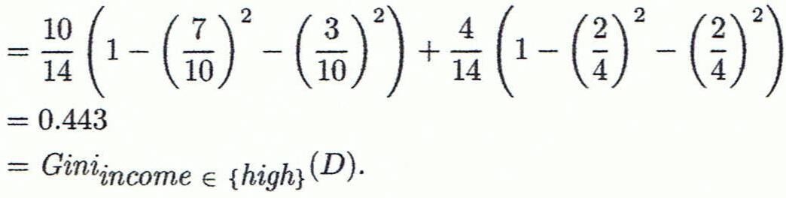
Computation of Gini Index
Ex. D has 9 tuples in buys_computer = “yes” and 5 in “no”
Suppose the attribute income partitions D into 10 in D₁: {low, medium} and 4 in D₂
Gini_{{low,high}} is 0.458; Gini_{{medium,high}} is 0.450. Thus, split on the {low,medium} (and {high}) since it has the lowest Gini index
All attributes are assumed continuous-valued
May need other tools, e.g., clustering, to get the possible split values
Can be modified for categorical attributes

Slide 81
RID | age | income | student | credit rating | Class: buys_computer
1 | youth | high | no | fair | no
2 | youth | high | no | excellent | no
3 | middle | high | no | fair | yes
4 | senior | medium | no | fair | yes
5 | senior | low | yes | fair | yes
6 | senior | low | yes | excellent | no
7 | middle | low | yes | excellent | yes
8 | youth | medium | no | fair | no
9 | youth | low | yes | fair | yes
10 | senior | medium | yes | fair | yes
11 | youth | medium | yes | excellent | yes
12 | middle | medium | no | excellent | yes
13 | middle | high | yes | fair | yes
14 | senior | medium | no | excellent | no
What is gini(D)?
What is ∆gini_{income}ϵ{low,medium}?
What is ∆gini_{income}ϵ{low,high}?
What is ∆gini_{income}ϵ{medium,high}?
Gini_{{low,high}} is 0.458; Gini_{{medium,high}} is 0.450. Thus, split on the {low,medium} (and {high}) since it has the lowest Gini index

